Slide 1
AWS Project
Interim Review
Static Web Hosting on S3
By Shaurya Srinet (RA2111032010006)
CSE-IoT (T2 Section)

Slide 2
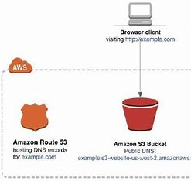
Application Architecture

Slide 3
Things Required
A host or a website
Creation of S3 Bucket
Configuration of S3 Bucket for Static Hosting
Bucket Policy

Slide 4
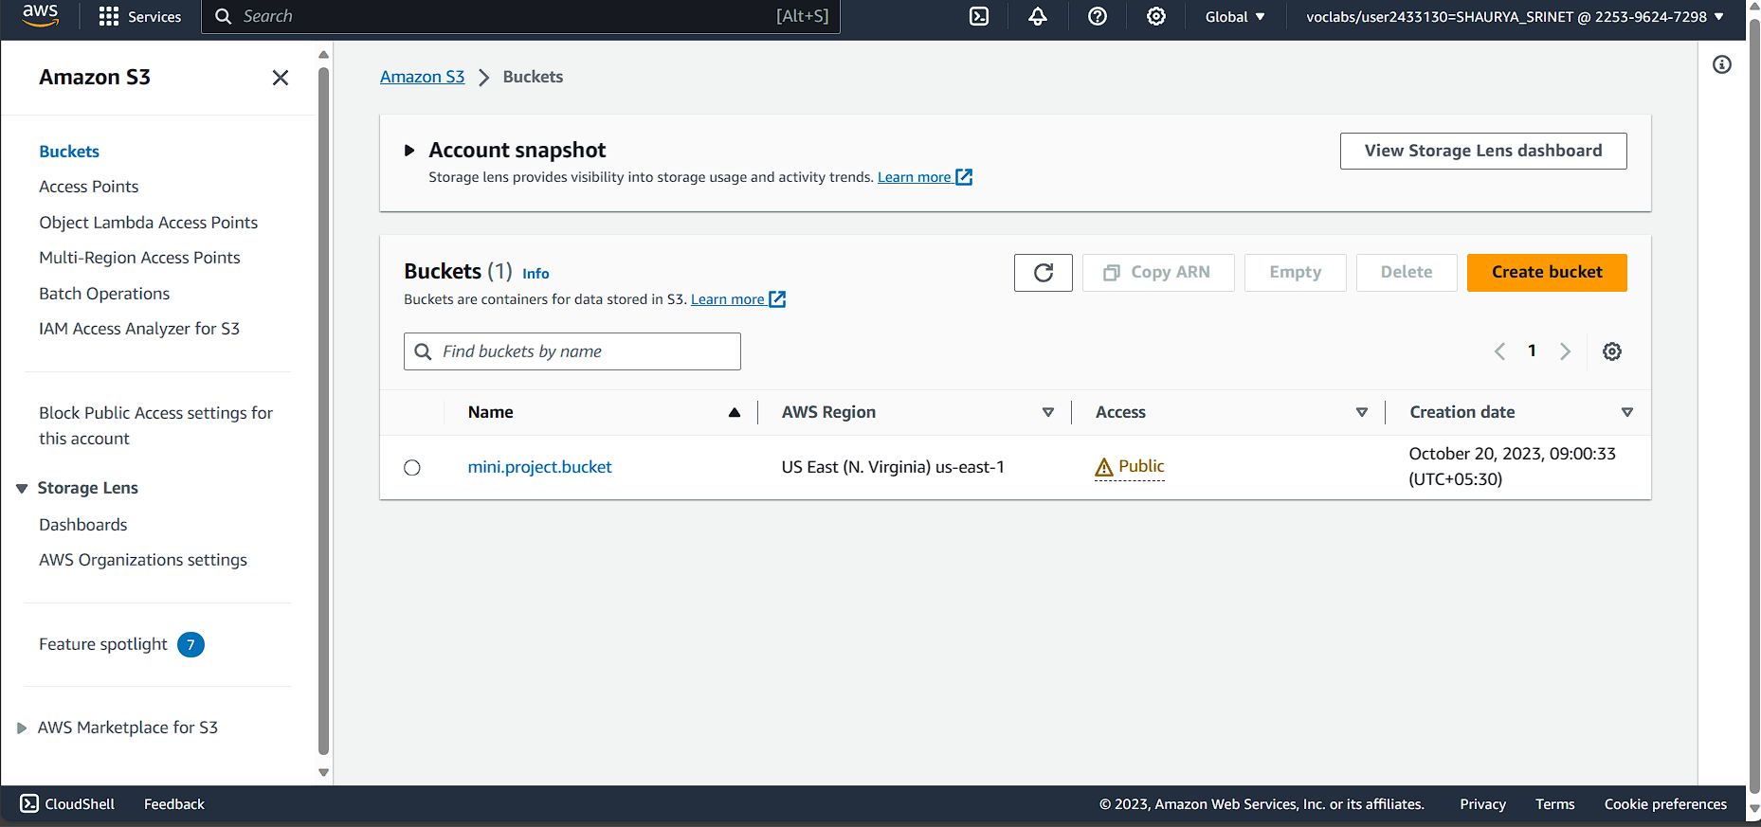
Amazon S3 Bucket Console

Slide 5
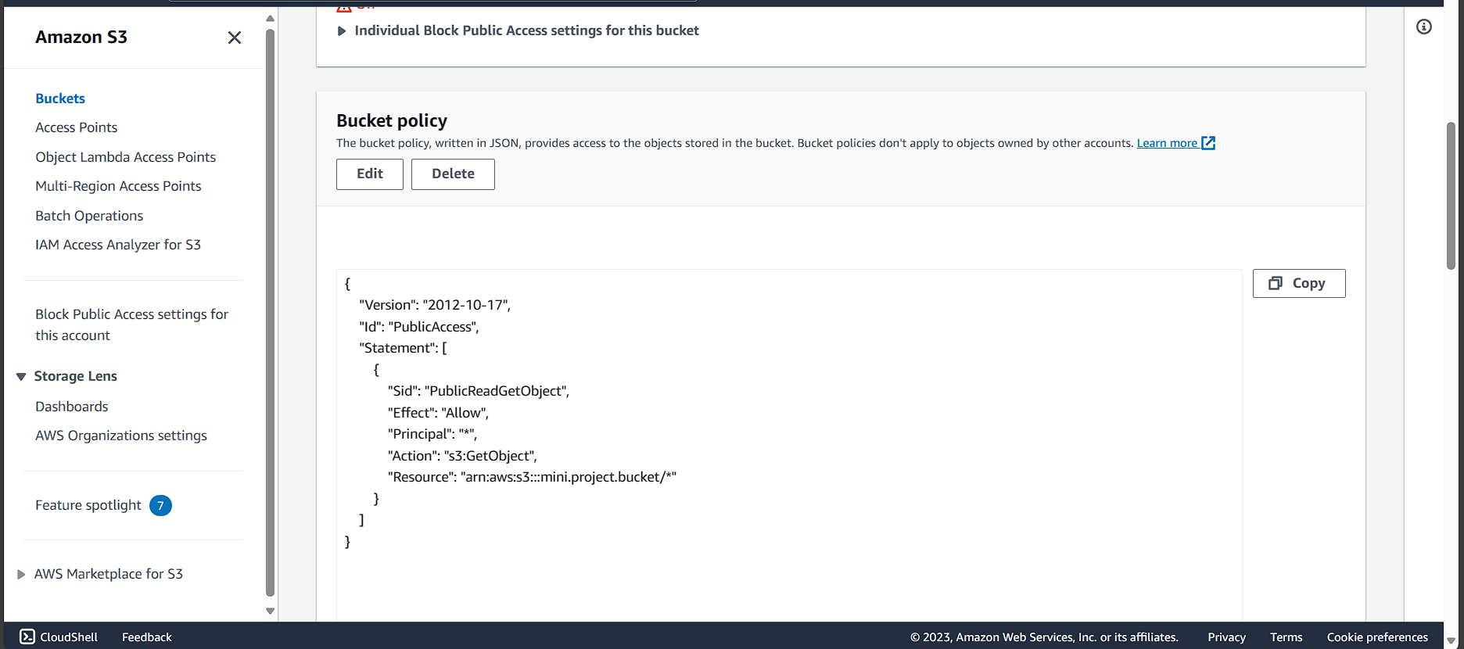
Amazon S3 Bucket Policy

Slide 6
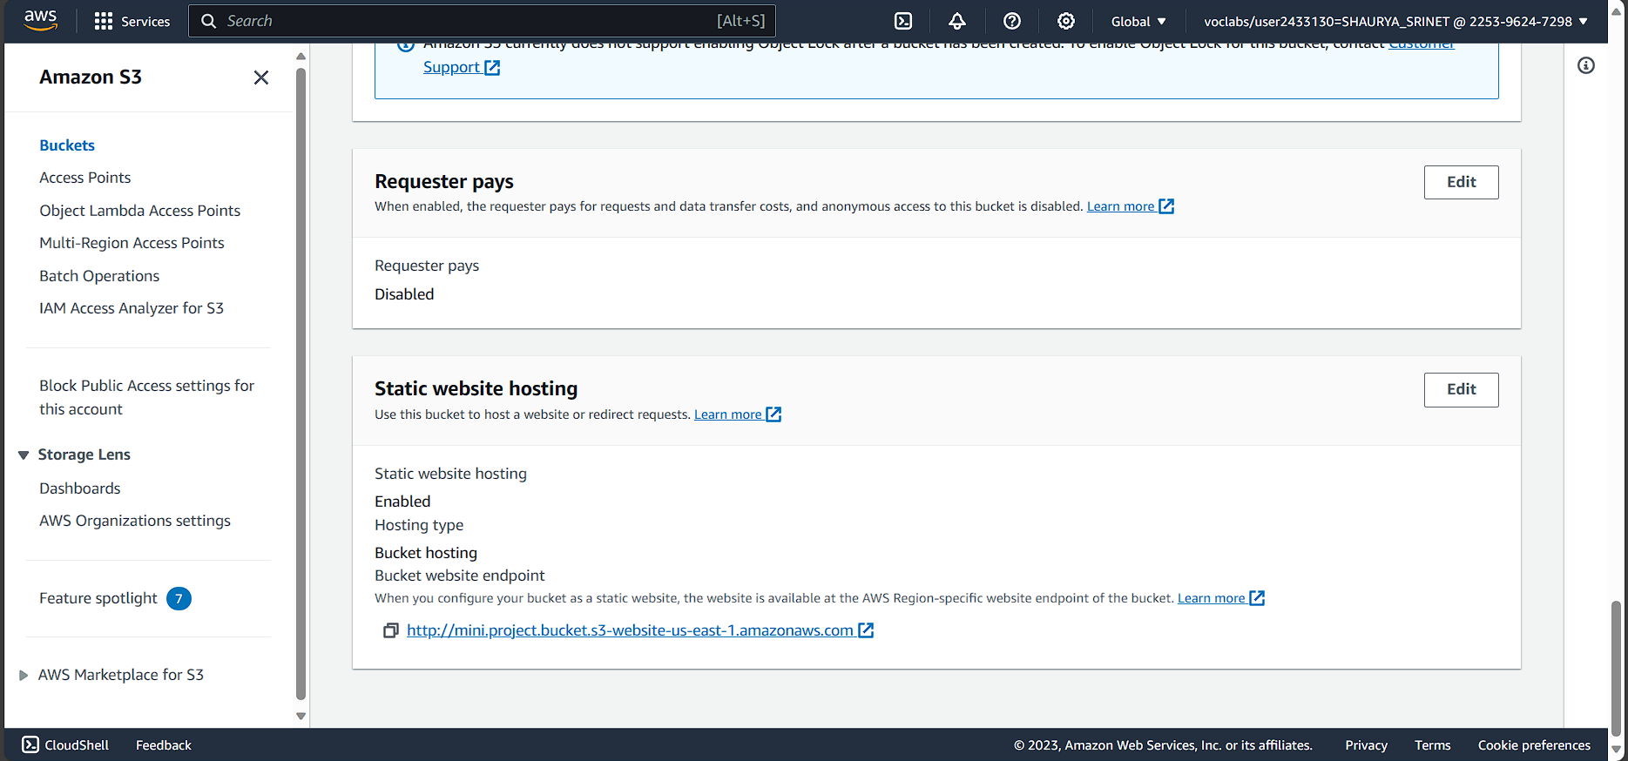
Amazon S3 Static Hosting Config

Slide 7

Service used

Slide 8
Problems Faced
IAM Permissions not given thus no other users has been created

Slide 9
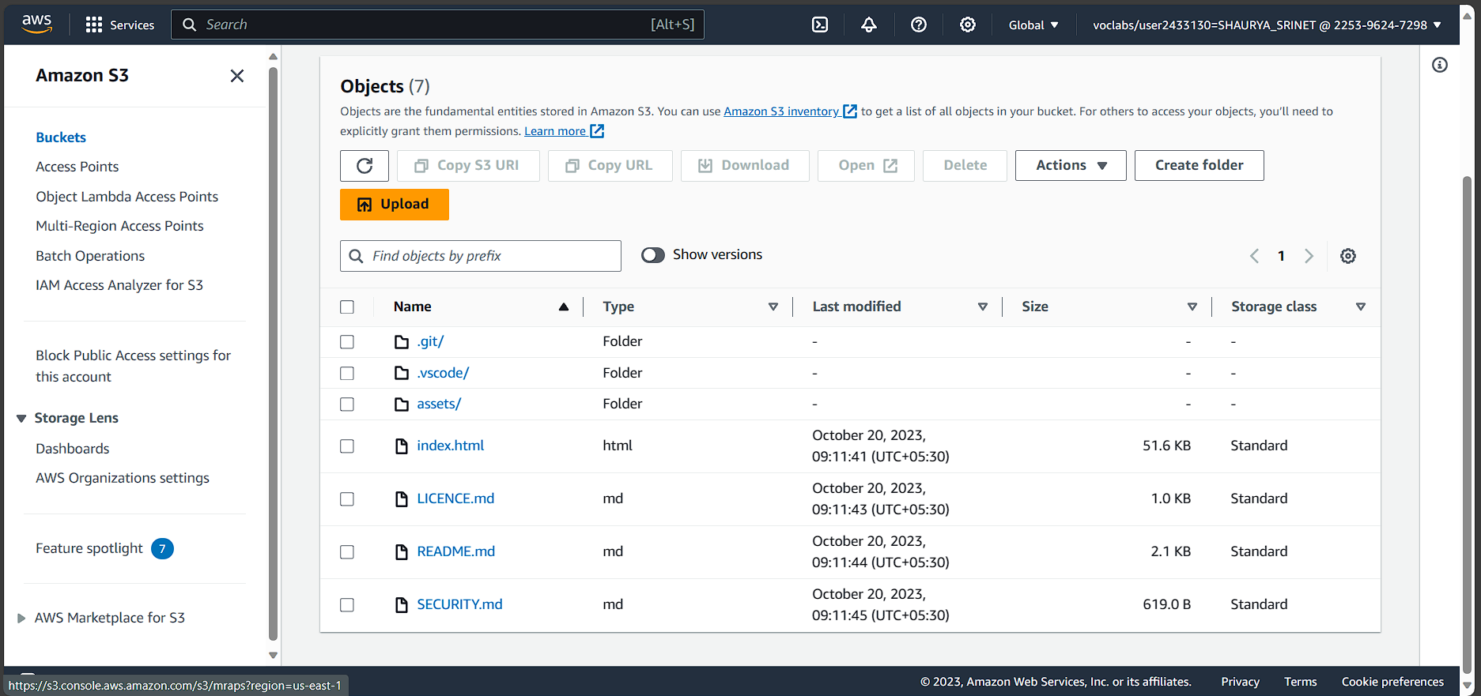
Source Code

Slide 10
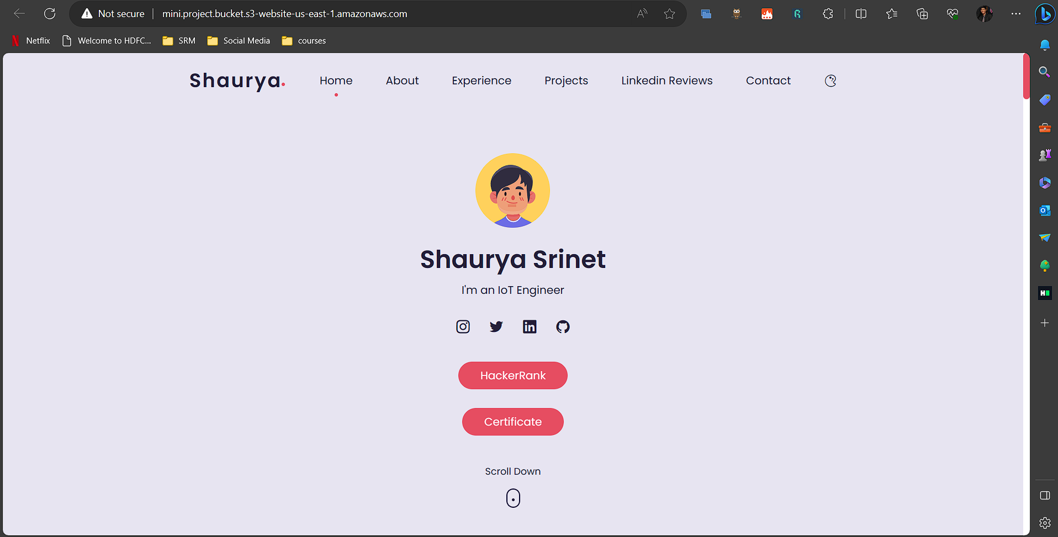
Expected Output

Slide 11
Thank You

